Slide 1
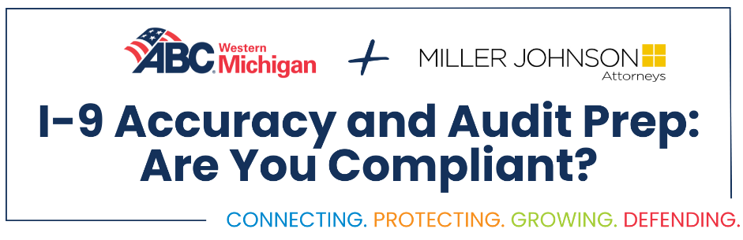
ABC Western Michigan:
I-9 Accuracy and Audit Prep
Are you Compliant?
Kevin D. Battle
Michael Stroster

Slide 3
I-9 Accuracy and Audit Prep
Current Administration
Overview of Form
I-9
Common I-9 mistakes
What is E-Verify ?
ICE audits
How to conduct an internal audit
How to correct
I-9 Forms
I-9 Best Practices

Slide 4
Current Administration
On January 25, 2025, President Donald Trump signed Executive Order: Protecting the American People Against Invasion. This order aimed at the following:
Expanding the enforcement priorities to included broader categories of removable immigrants, not just those with serious criminal convictions.
Revoking federal funding from jurisdictions that failed to comply with federal immigration laws.
Increasing ICE presence to conduct more worksite enforcement operations, including audits and raids on businesses suspected of employing undocumented workers.

Slide 5
Current Administration Cont.
Impact on I-9 Compliance and Employers:
President Trump’s executive order intensifies enforcement actions against businesses employing unauthorized workers
Potential for increased ICE workplace audits, unannounced job site visits, and stricter penalties for I-9 violations
These enforcement actions may create significant challenges for employers, even those who follow the order, including unexpected job site disruptions, potential work stoppages, and employee detentions

Slide 6
Overview of Form I-9

Slide 7
Why Care About I-9s?
Employers who violate the I-9 rules are
subject to:
  Fines
  Criminal penalties
  Debarment from government contracts
  Back pay
  Order to fire affected individuals*

Slide 8
I-9 Compliance
ALL employees hired after November 6, 1986, are required to have an Employment Eligibility Verification Form (Form I-9) on file with the employer
Includes U.S. citizens!

Slide 9
Section One
Employee must fill out Section One after job accepted, but no later than first day of employment
Name (maiden name)
Address
Date of Birth
Check status in United States
  Work authorization must include expiration date
Signature and date (required even if prepared by translator)
Preparer or translator certification
Social Security Number, Email, Phone

Slide 10
Section Two: Form Completion and Document Verification
Employer must complete the form within 3 business days of the date employment begins
Employer must review the original documents and complete Section Two
  Document title
  Issuing authority
  Document number
  Expiration date (if any)
  Date employment begins (often missed)

Slide 11
Section Two: Employee Document Submission Guidelines
Employees must provide documents within 3 business days of the date employment begins
If not in possession of documents, must provide a Receipt Notice or I-94 Card within 3 business days and the actual documents within 90 days
Employees are not required to show a Social Security card for I-9 purposes unless the employer participates in E-Verify

Slide 12
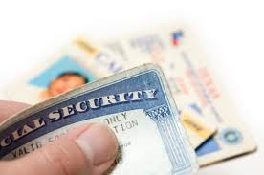
Section Two: Document Verification
Examine one document from List A or one document from List B and one from List C
Employer cannot specify which documents they will accept from an employee

Slide 13
Section Two: What Are You Certifying?
On its face, the document reasonably appears:
  1) To be genuine
  2) To relate to the employee
You are not attesting to the person’s status or identity

Slide 14
Updating And Reverification
THIS IS CRITICAL!
Employee name changes
Employee leaves and is rehired
Work authorization expired

Slide 15
Current Form I-9
On January 20, 2025, the USCIS released a new version of the Form I-9
All employers must use the new Form I-9
No Substantial changes to employer obligations on new form

Slide 16
Most Common I-9 Mistakes Seen on Form I-9

Slide 17
Section One: Common Mistakes
Most Common Mistake:
  Forgetting to check the appropriate box
    A Citizen of the U.S.
    A noncitizen national of the U.S.
    A lawful permanent resident
    An alien authorized to work
Section Two: Common Mistakes
  Missing certification date
  Missing employer representative name

Slide 18
E-Verify

Slide 19
What is E-Verify?
E-Verify is an Internet-based system that compares information from an employee's Form I-9, to data from U.S. Department of Homeland Security and Social Security Administration records to confirm employment eligibility
Allows employers to confirm an employee’s U.S. employment eligibility in as little as 3 to 5 seconds

Slide 20
E-Verify
E–Verify is not:
  A system that provides immigration status
  Used for prescreening
  A safe harbor from worksite enforcement

Slide 21

E-Verify Cont.
Employer enrollment in E-Verify is voluntary, except when it is mandatory …
  Federal contractors and subcontractors
  E-Verify mandates vary by state

Slide 22
DHS / ICE Audits

Slide 23
DHS / ICE Audits
In the administrative setting, the playing rules tend to favor the government
Investigating ICE agents issue their own subpoenas for employers' records
Administrative judges determine the facts and the defendant's liability
Juries are not an option

Slide 24
I-9 Audits: Identifying Issues and Enforcing Penalties
I-9 Audit - Discover improper documentation or maintenance
Audits can lead to further investigation and significant fines and penalties
Going after corporate officers, human resource representatives, supervisors, and contractors

Slide 25
Enhanced Civil Fines and Criminal Penalties
USCIS substantially increasing fines for I-9 violations
Effective January 2, 2025
Fines raised across categories

Slide 26
Penalties for Employing Unauthorized Aliens
Knowingly hired, or to have knowingly recruited or referred for a fee, an unauthorized alien for employment in the United States or to have knowingly continued to employ an unauthorized alien in the United States
  1st Offense Min./Max: $716 to $5,724
  2nd Offense Min./Max: $5,724 to $14,308
  3rd Offense Min./Max: $8,586 to $28,619

Slide 27
Civil Fines
Failing to comply with Form I-9 employment verification requirements (paperwork violations)
Fines range from $288 to $2,861

Slide 28
Civil Fines And Criminal Penalties Cont.
Unlawful discrimination against an employment-authorized individual in hiring, firing, or recruitment or referral for a fee
Engaging in a pattern or practice of hiring, recruiting, or referring for a fee unauthorized aliens

Slide 29
Good Faith Defense
Employers who can show that they have acted in good faith in documenting and retaining I-9s can defend against many of these penalties

Slide 30
Internal Audit

Slide 31
Conducting Internal Audit
If you conduct an internal I-9 audit you will find errors
The simple advice is: fix the mistakes when you find them
The Complicated advice is: don't make things worse

Slide 32
Correcting Your I-9s
What you should do:
  Be consistent. Whatever you decide, do it for everyone.
  Compare your I-9s against an employee payroll list. This is how ICE begins.
  Consider making a chart that summarizes all of the corrections and why they were made

Slide 33
Correcting Your I-9s Cont.
What you should not do:
  Erase, use whiteout, correction tape or black marker
  Correct things that do not need it
  Backdate corrections or otherwise make it appear as though it was correct from the beginning

Slide 34
Best Practices

Slide 35
Best Practices
Have a written policy in place which states the company’s position on immigration compliance and completion of the I-9 forms
Do not store the I-9 forms with the employee personnel files. This could lead to the Department of Homeland Security or the Department of Labor reviewing all of your personnel files.

Slide 36
Organizing I-9 Forms: Three Essential Files
If you maintain paper I-9s:
  Store the I-9 forms in three separate files
  One for current employees for whom reverification will never be required
  One for current employees for whom reverification is required
  One for terminated employees
If you store I-9s electronically:
  You need access to currently employed employees.
  I-9 retention obligation still applies

Slide 37
I-9 Compliance Essentials
Provide the I-9 instructions to the newly hired employee at the time the I-9 form is being completed.
Develop resources and reference materials for use by the company representative who will complete and maintain the I-9 forms, including a copy of your written policy and a copy of the government’s I-9 Handbook for Employers.
Perform periodic internal audits of your I-9 forms to ensure adherence to your policy.

Slide 38
I-9 Compliance Essentials
I-9 Document Retention Timelines:
  Federal regulations state you must retain a Form I-9 for each person you hire for three years after the date of hire, or one year after the date employment ends, whichever is later
  When an employee stops working for you should you calculate how much longer you must keep their Form I-9

Slide 39
What do we do when ICE shows up at the job site?

Slide 40
When ICE shows up
Your facilities are private property and are not open to any unauthorized or unsupervised visitors. Accordingly, law enforcement is not permitted to enter private areas of your business without a valid judicial warrant signed by a judge.
Initial Interaction:
  Politely greet the law enforcement officer at the facility's main public entrance.
  Request to see official identification and inquire about the purpose of their visit.
  Inform the officer that you will need to notify Human Resources for instructions.

Slide 41
When ICE show up
Obtain Documentation:
  Ask the officer to provide any legal documents claiming to authorize their action, such as a warrant.
  Obtain officer name, contact, agency, badge number (do not attempt to photocopy an official badge or Government ID).
  Do not share information or consent to access the facility.
Contact Administration:
  Contact Human Resources immediately. If HR is not available contact your supervisor.
  Do not disclose any information about any employee.
  Do not give consent to allow the officer to proceed with any enforcement action on the premises.

Slide 42
I-9 ACCURACY AND AUDIT PREP
    Questions & Answers

